Slide 1
Colorectal Cancer Clinical Trials
Trial Team: giclinicaltrials@imperial.ac.uk
Prof Gina Brown: gina.brown@imperial.ac.uk
Caroline Martin
Syvella Ellis
Hammersmith Hospital Campus
Imperial College London
W12 0NN
Amendments have been submitted for all trials to extend recruitment to April 2026 due to delays in transferring sponsorship
www.profginabrown.com

Slide 2
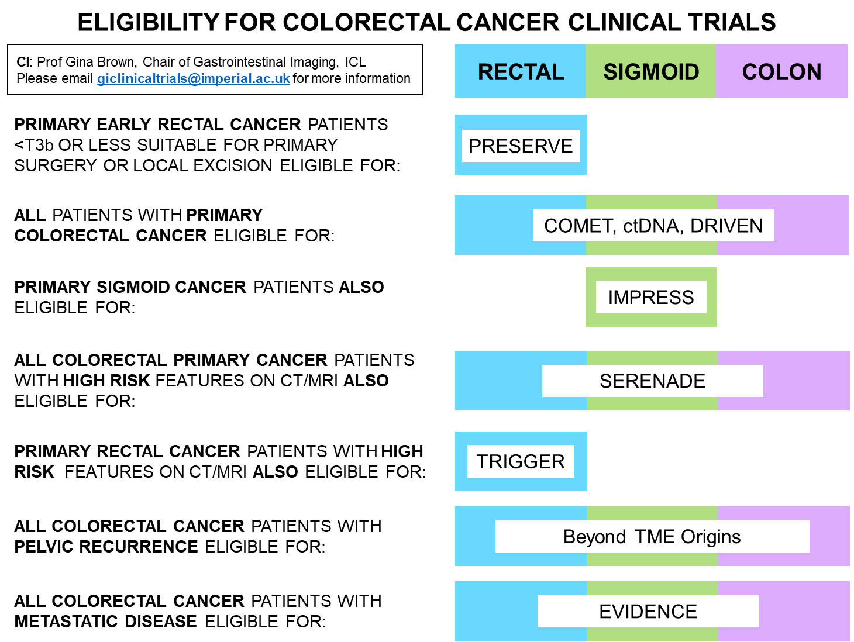
giclinicaltrials@imperial.ac.uk

Slide 3
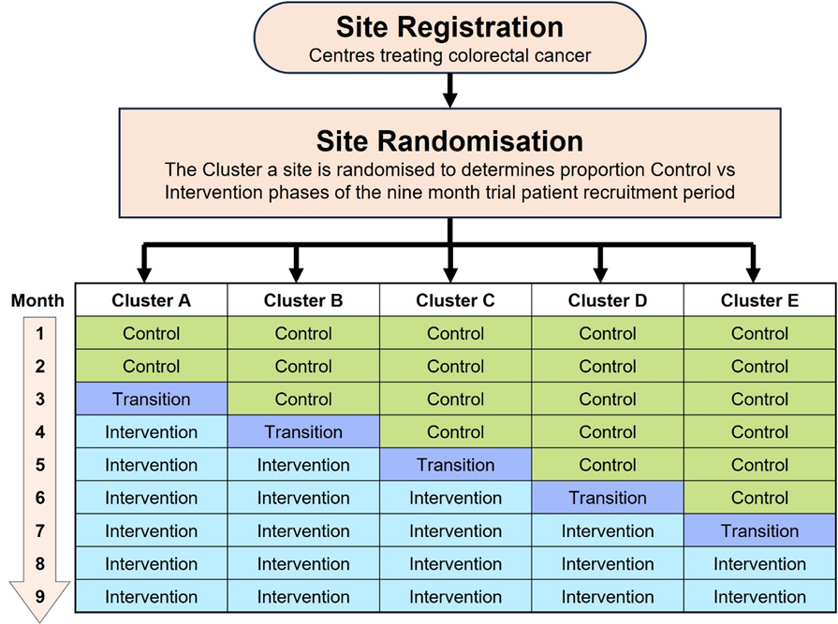
PRESERVE: MRI to prevent over-treatment of early rectal cancer
IRAS Number: 256736 CPMS ID: 41403
ClinicalTrials.gov ID: NCT04103372
Why the PRESERVE trial?
We want to measure the impact of a training intervention in the application of a systematic reporting approach to MRI scans against current (pre-intervention) practice.
We want to find out: if we can increase the numbers of patients with cancer who are diagnosed at an earlier stage by improving accuracy of MRI staging and minimising the numbers of ‘missed’ or over-staged cancers.
giclinicaltrials@imperial.ac.uk

Slide 4
PRESERVE
Early Rectal Cancer Meeting
Friday 15th March 2024
The Royal Society of Medicine
1 Wimpole Street London W1G 0AE
All members of the colorectal MDT and research portfolio teams are welcome, including clinicians, nurses, coordinators, managers and any healthcare professional who attends
Working together to improve rectal preservation rates in patients with early rectal cancer
Registration Link:
https://profginabrown.com/percm-registration/
giclinicaltrials@imperial.ac.uk

Slide 5
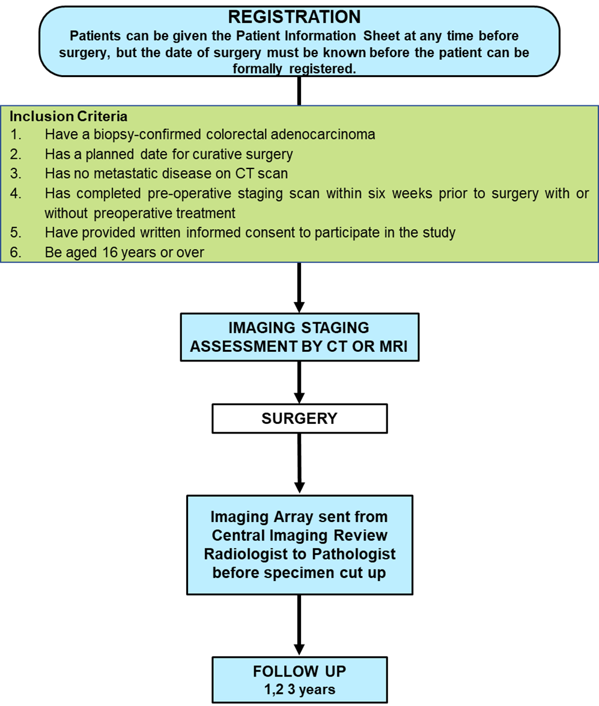
COMET: Improving the detection and staging of tumour deposits vs Lymph nodes
IRAS Number: 217627 CPMS ID: 55248
ClinicalTrials.gov ID: NCT03303547
Why the COMET trial?
Proving that the lesions seen on Imaging (MRI or CT) are extranodal tumour deposits and have a worse outcome than lymph node positive status will alter the way we stage patients with colorectal cancer.
We want to find out: if patients are being underdiagnosed on routine pathology. If this is the case, they may be missing out on adjuvant therapy which could have reduced their risk of recurrence
giclinicaltrials@imperial.ac.uk

Slide 6
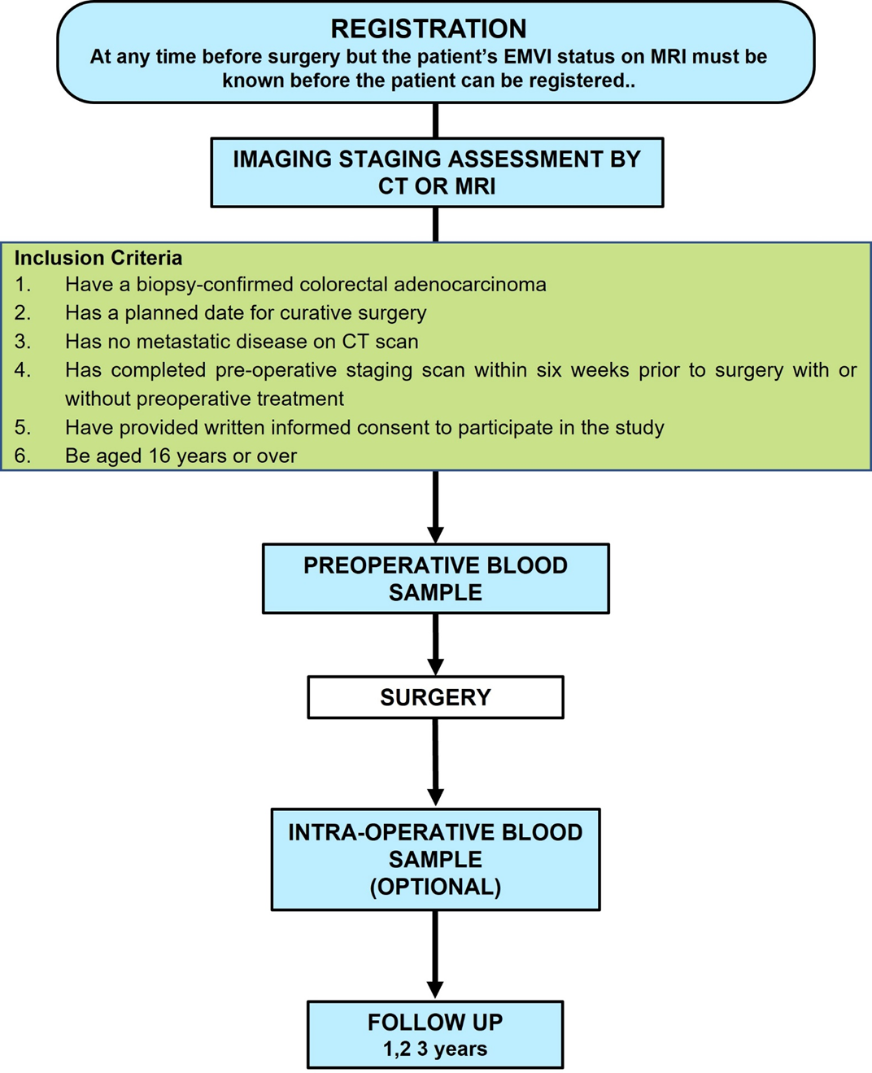
Is ctDNA linked to positive radiology EMVI status?
IRAS Number: 136894 CPMS ID: 19730
ClinicalTrials.gov ID: NCT02579278
Why the ctDNA trial?
The measurement of (circulating tumour DNA) ctDNA in patients with radiology EMVI positive and negative tumours will help provide a biological explanation for the increased risk in disease recurrence in radiology EMVI positive patients and further support the use of EMVI as an imaging biomarker.
We want to find out: if ctDNA % mutation frequency of EMVI positive colorectal cancer is raised. By validating EMVI as a predictive imaging biomarker we aim to add further support for escalation of treatment and surveillance in cases where there is radiologic vascular invasion despite preoperative therapy.
giclinicaltrials@imperial.ac.uk

Slide 7
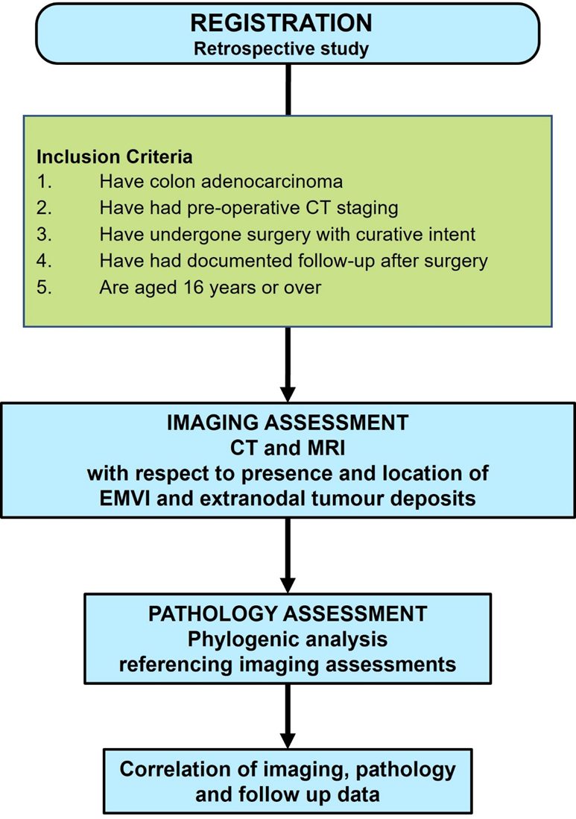
DRIVEN: to stage colorectal cancers using TDV
IRAS Number: 287131
Why DRIVEN?
The ctTDV system seeks to replace conventional TNM with staging based on depth of spread, tumour deposits (TDs) and EMVI. If validated, it could stratify treatment for patients with colorectal cancer with the aim of improving patient outcomes and reducing the disparity in overall survival amongst colorectal cancer patients
We want to find out: if the ctTDV staging tool could be of use in stratifying the surgical and oncological management of patients with colon cancer and between the different operations for colorectal cancer
giclinicaltrials@imperial.ac.uk
Notes:
Imaging assessment CT or MRI, inclusion colon or rectal adenocarcinoma

Slide 8
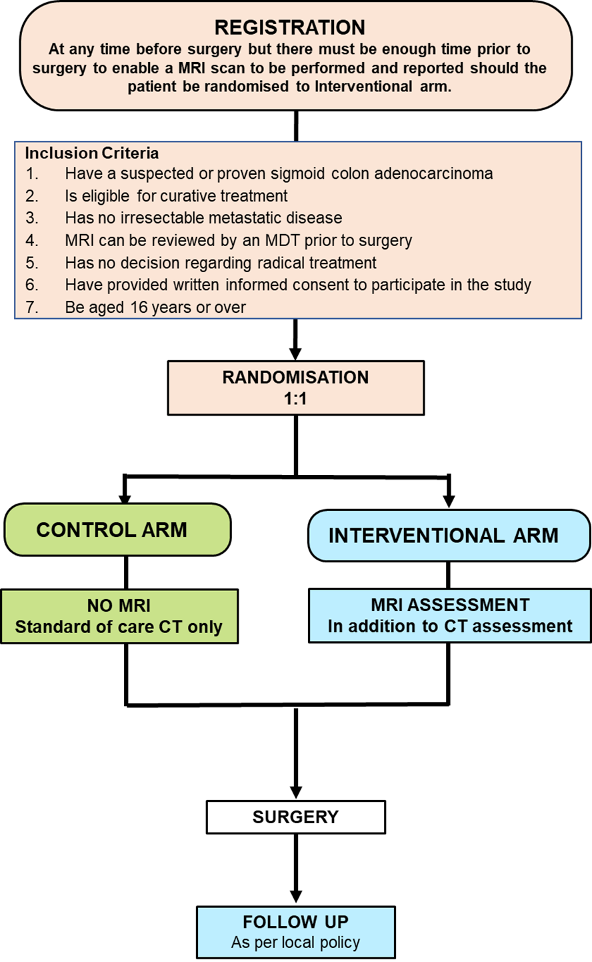
IMPRESS: MRI to improve preoperative staging of sigmoid cancer
IRAS Number: 137312 CPMS ID: 17006
ClinicalTrials.gov ID: NCT02222844
Why IMPRESS?
We propose that improvements can be achieved by assessing pelvic sigmoid cancers preoperatively using MRI. If patients with high risk sigmoid cancers can be identified preoperatively, they could benefit from preoperative surgical and oncological treatment planning.
We want to find out: if using MRI imaging to plan treatment will result in a greater proportion of patients being given radical treatment compared to those patients who only had CT imaging. Radical treatment might involve neoadjuvant chemotherapy, neoadjuvant chemoradiotherapy and/or extended surgery
giclinicaltrials@imperial.ac.uk

Slide 9
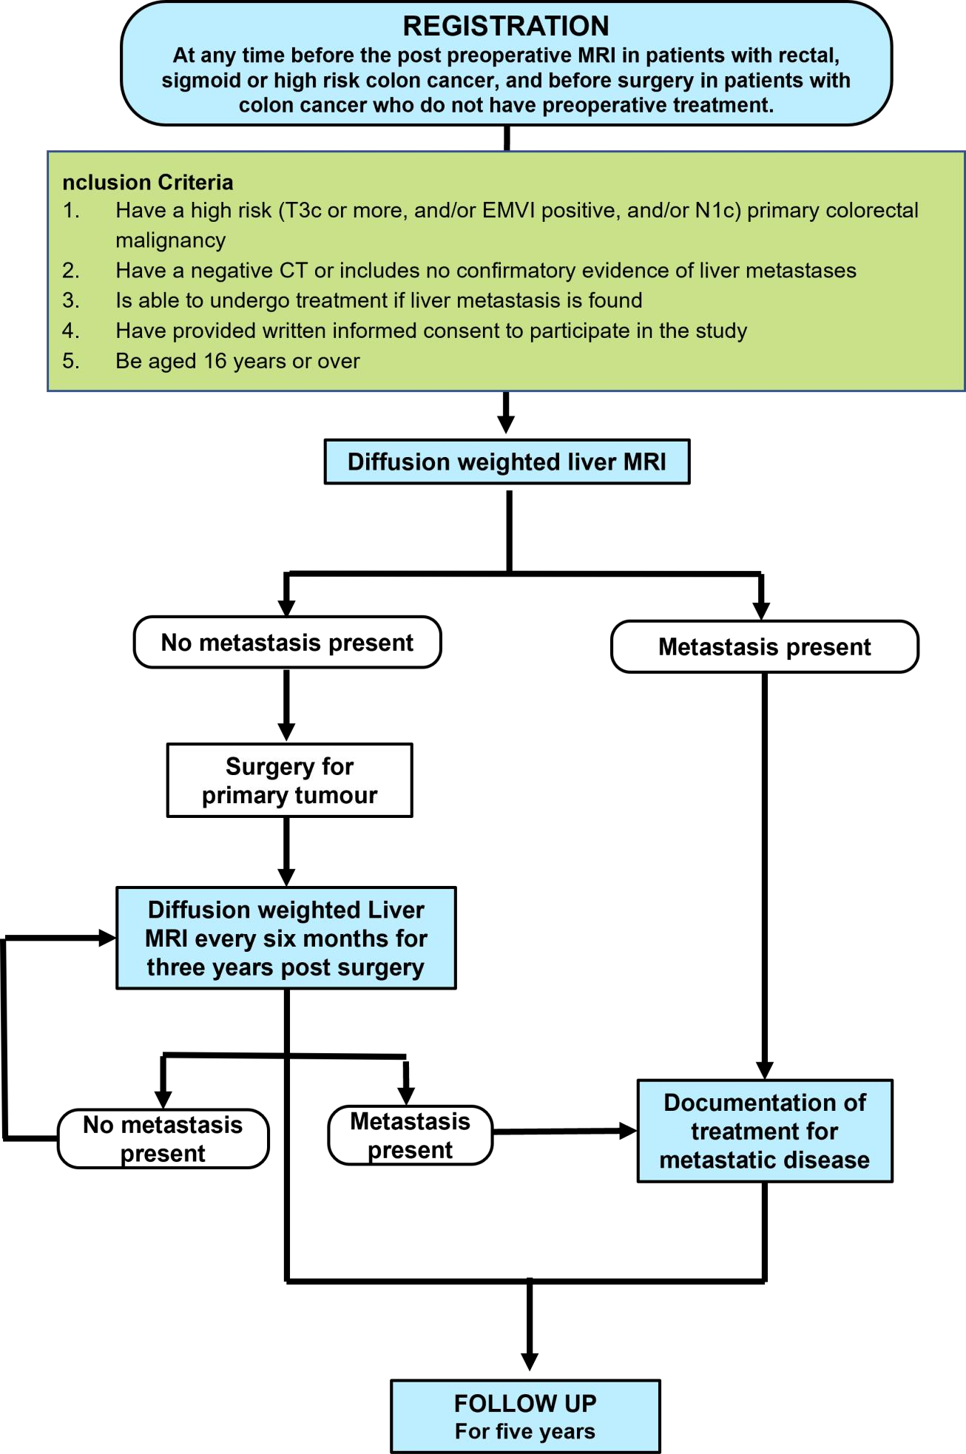
SERENADE: early detection of liver metastases in high risk colorectal patients
IRAS Number: 135981 CPMS ID: 17059
ClinicalTrials.gov ID: NCT02246634
Why SERENADE?
Can we detect liver metastases using hepatic diffusion weighted MRI surveillance compared with standard CT surveillance in the first two years from diagnosis
We want to find out: if liver metastases in patients with high-risk colorectal cancers can be identified earlier using MRI than CT resulting in earlier treatment and therefore are more likely to undergo a curative resection if detected sooner.
giclinicaltrials@imperial.ac.uk

Slide 10
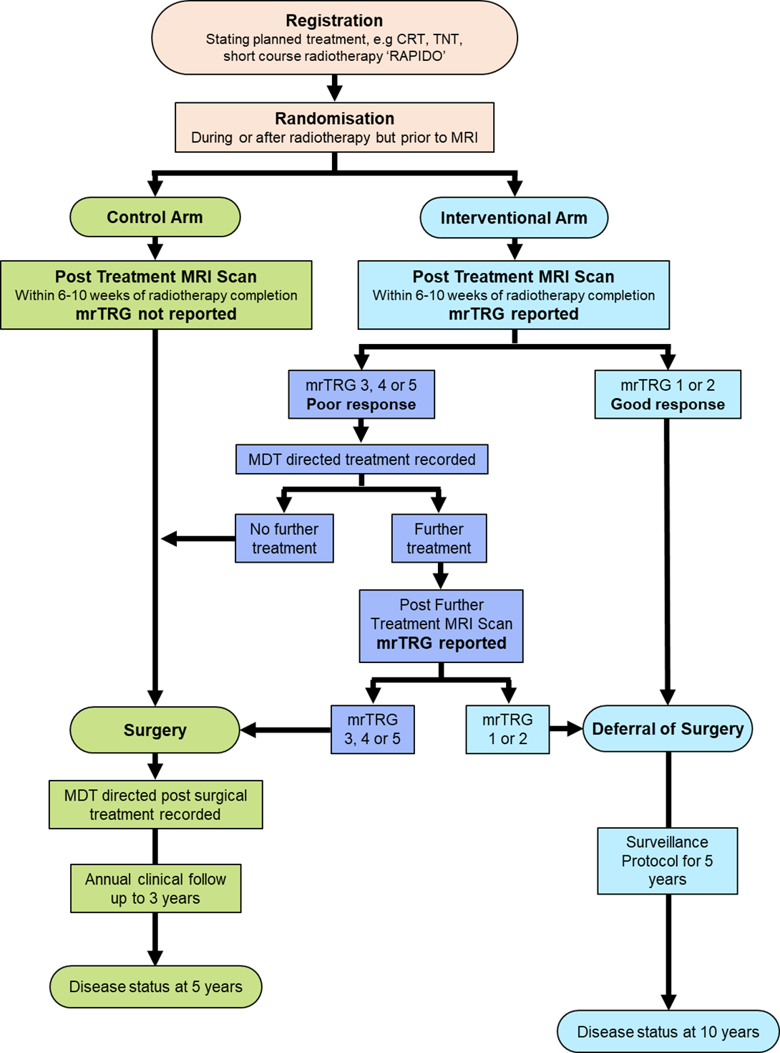
TRIGGER: using MRI to identify patients who can have watch and wait instead of surgery after preoperative therapy
IRAS Number: 156408 CPMS ID: 20576
ClinicalTrials.gov ID: NCT02704520
Why TRIGGER?
No prospective trials have stratified rectal cancer management according to the initial response to treatment using mrTRG or any other biomarker for response to treatment.
We want to find out: if mrTRG can be used as a personalised MRI directed dual management approach;‘good responders’ will be offered the opportunity to avoid surgery altogether and instead undergo a surveillance protocol (watch & wait); ‘poor responders’ to radiotherapy will be evaluated to determine how the mrTRG assessment influences MDT decision making such as offering additional treatment to enable further downstaging.
giclinicaltrials@imperial.ac.uk

Slide 11
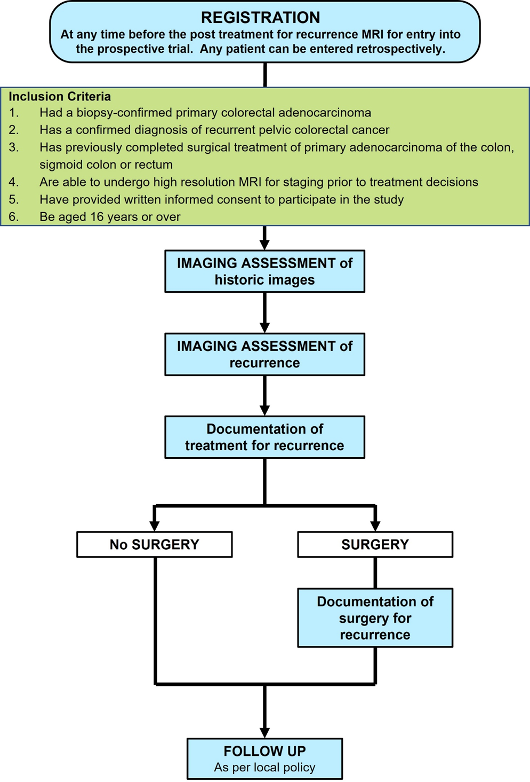
Beyond TME Origins: investigating the staging, treatment, origins and prevention of recurrent pelvic cancer
IRAS Number: 136843 CPMS ID: 17065
ClinicalTrials.gov ID: NCT02292641
Why Beyond TME Origins?
We are using a specifically designed imaging assessment proforma to document not only the anatomic compartments of recurrence but also the cause based on its pattern of spread and how this relates to the primary tumour. In this way, we aim to prevent future cancer deaths from recurrences
We want to find out: why patients recur, how recurrences manifest and how we can optimally treat patients with recurrence.
giclinicaltrials@imperial.ac.uk

Slide 12
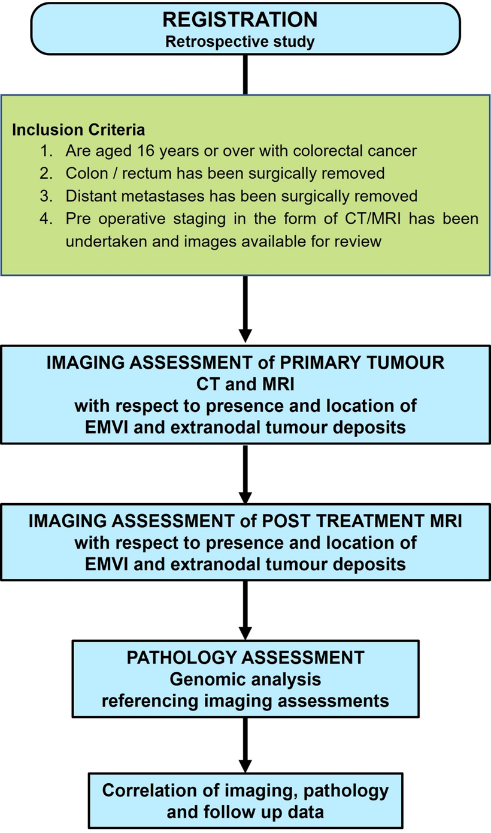
EVIDENCE: investigating the pathway of cancer spread to distant organs in colorectal cancer
IRAS Number: 288231 CPMS ID: 55248
Why EVIDENCE?
A proof for a vascular route of spread rather than lymph nodes would lead to a paradigm shift in future decision making at national and international level.
We want to find out: whether the vascular route of spread (as evidenced through EMVI and tumour deposits) is more important than lymph nodes in the development of metastatic disease.
giclinicaltrials@imperial.ac.uk

